Slide 1
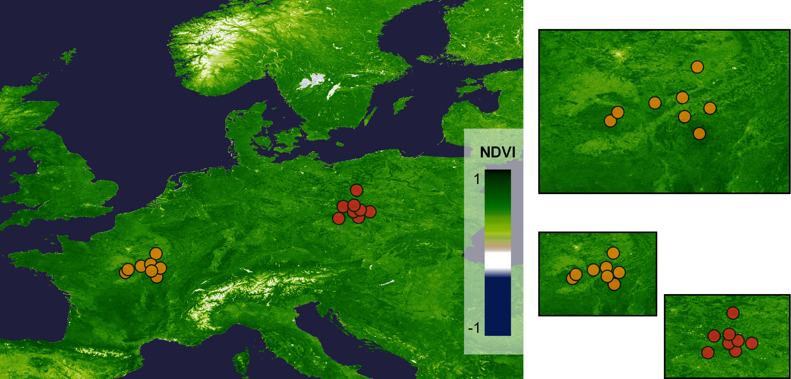
a)
b)
Predictability
Training site
Testing site
Regression fit
Biodiversity measure
Prediction error
Testing sites permuted within studies
Environmental predictor
Study properties
c)
Transferability
Biodiversity measure
predicts
Testing sites permuted among studies
Prediction error
Training site (Study 1)
Sites (Study 2)
Testing site (Study 2)
Regression fit
Environmental predictor
Study properties

